Slide 1

Testing BME680 sensor for air quality seminar work Authors: Metodija Bucevski, Jernej Koželj
14.5.2021

Slide 2
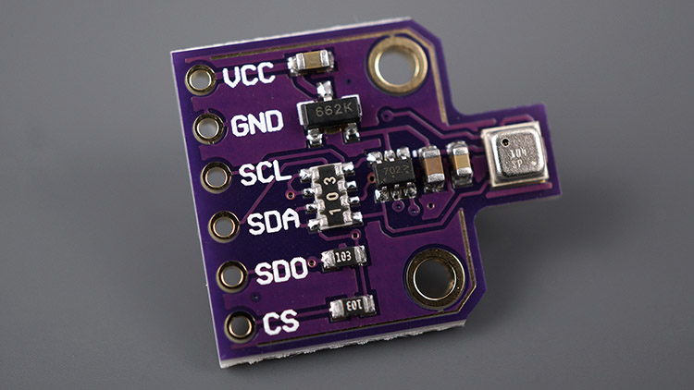
Introduction
BME680 is an environmental digital sensor,
Great for indoor air quality control,
Temperature, humidity, air pressure and gases.

Slide 3
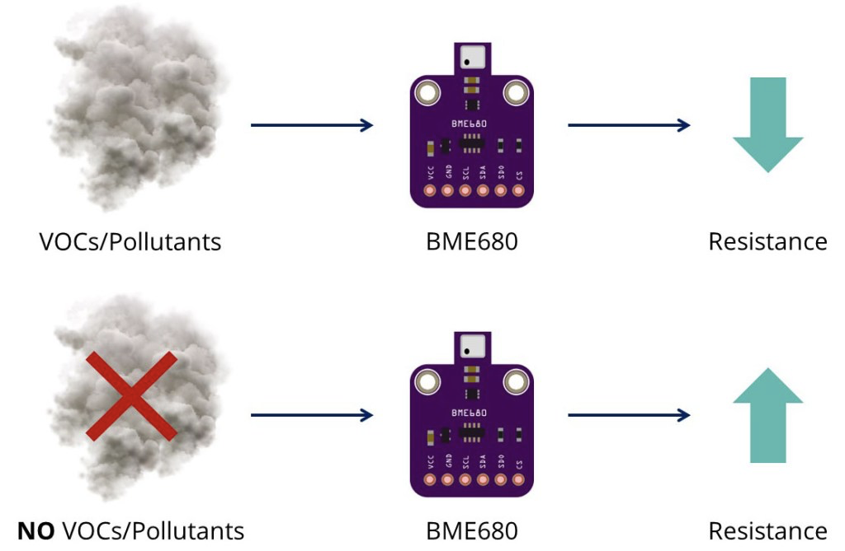
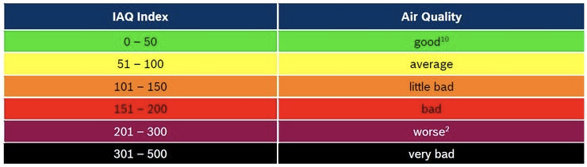
BME680 Gas sensor
Can detect VOCs in the air,
VOC (Volatile organic compounds),
Gives qualitative idea of VOCs in the air.

Slide 4
Experiments
Testing the sensor for air quality,
Using the I2C protocol for communication,
Using nRF24L01 low power near distance communication for data transfer to MQTT server,
Lighting the LED if air quality above/below threshold.

Slide 5
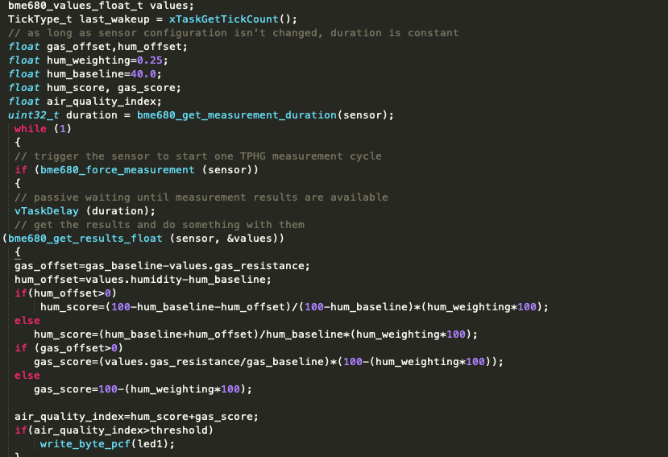
Air Quality Index

Slide 6
Future work
Implementing BME680 sensor in real life scenario in a smart home,
Using other technologies (Raspberry Pi, Docker, Grafana, Python,...).

Slide 7
Conclusions
Problems with Eclipse...,
BME680 makes a good air quality indicator for home use,
Air quality is pretty good in our home environment.

Slide 8
Thank you for your time.

